Slide 1
SL(2,Z) Action on AdS/BCFT and Hall conductivity
Mitsutoshi Fujita
Department of Physics, University of Washington
Collaborators : M. Kaminski and A. Karch
Based on arXiv: 1204.0012[hep-th]
accepted for publication in JHEP

Slide 2
Contents
Introduction of boundaries in the AdS/CFT:
the AdS/Boundary CFT (BCFT)
Derivation of Hall current via the AdS/BCFT
SL(2,Z) duality in the AdS/CFT correspondence: Review
A duality transformation on AdS/BCFT
Stringy realization

Slide 3
Introduction of boundaries in AdS/CFT
The dynamics of strong-coupling theory can be solved using the AdS/CFT correspondence.
Maldacena ``97
We want to add the defects and boundaries in CFT for the application to the condensed matter physics.
Example: the boundary entropy, edge modes, a local quench

Slide 4
Introduction of boundaries in AdS/CFT
We can introduce defect in the probe limit.
Karch-Randall ``01
We understand the defect with backreaction in the context of Randall-Sundrum braneworlds (bottom-up model with thin branes).
Randall-Sundrum, ``99
String theory duals to defects with backreacting defects and boundaries
D’Hoker-Estes-Gutperle, ``07
Aharony, Berdichevsky, Berkooz, and Shamir, ``11

Slide 5
Introduction to AdS/BCFT
General construction for boundary CFTs and their holographic duals
Takayanagi ``11
Fujita-Takayanagi-Tonni ``11
Based on the thin branes
Including the orientifold planes, which in the context of string theory are described by thin objects with negative tension.

Slide 6
Gravity dual of the BCFT
We consider the AdS₄ gravity dual on the half plane.
The 4-dimensional Einstein-Hilbert action with the boundary
term
Isometry SO(2,2) in the presence of Q₁
The boundary condition
The AdS₄ metric
This is restricted to the half plane y>0 at the AdS boundary.

Slide 7
Gravity dual of the BCFT
The spacetime dual to the half-plane
the vector normal to Q₁ pointing outside of the gravity
region
the vector parallel to Q₁
The extrinsic curvature and the tension T
, where .
The ends of this interval are described by no defect.

Slide 8
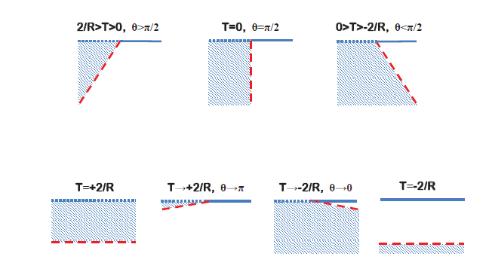
Gravity dual of the BCFT
Embedding of the brane corresponding to various values of the tension.
,
Θ₁ is related with the boundary entropy!
Θ₁
Just hard wall

Slide 9
The effective abelian action
The boundary term makes the action gauge invariant if
We introduce the effective abelian action
The solutions for the EOM:
The boundary condition at Q₁ : Neumann boundary condition
The solutions to the boundary condition
With the boundary condition

Slide 10
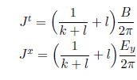
The GKPW relation
The current density derived using the GKPW relation
Gubser-Klebanov-
-Polyakov ``98
Witten ``98
3 independent boundary conditions and the AdS boundary
conditions determine the current.
The conductivity becomes for
setting For
and ,
Describing the position independent gap and the standard Hall physics
FQHE

Slide 11
Dirichlet boundary condition on Q₁
We choose the different boundary condition at Q₁
Rewritten as
The current at the AdS boundary
Vanishing J^{y}
The Hall conductivity
Cf. B appears in the second order of the hydrodynamic expansion for T>>0.

Slide 12
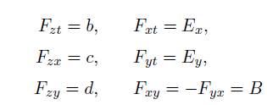
Generalized and transport coefficients
The most general constant field strength
gives non-zero off-diagonal conductivities
Κ_{t} is present in any theory with a mass gap
.
satisfies the condition at the boundary Q and the condition
Non-trivial relations of coefficients
Relation of Hall physics

Slide 13
Novel transport coefficients
The gradient of the condensate gives rise to B dependent term
Bhattacharyya et al. ``08
Following effective theory realizes the above relation.
Do we satisfy onsager relations?
if
Parameters breaking
time reversal

Slide 14
A duality transformation of D=2 electron gas and the discrete group SL(2,Z)

Slide 15
D=1+2 electron gas in a magnetic field
Consider the d=1+2 electron gas in a magnetic field
low temperature ~ 4K
suppression of the phonon excitation
Strong magnetic field B~ 1- 30 T
states of the electron is approximately quantized via the Landau level
The parameters of electron gas are the electron density and the magnetic flux.
Filling fraction ν=(2π)J^{t}/B

Slide 16
The duality transformation in the d=2 electron gas
The states of different filling fractions ν=(2π)J^{t}/B are related by
(i)
(ii)
(iii)
Girvin ``84, Jain-Kivelson-Trivedi ``93, Jain-Goldman ``92
ν transforms under the subgroup Γ₀(2) SL(2,Z) like
the complex coupling τ
Landau level addition
Particle-hole transition
Flux-attachment

Slide 17
SL(2,Z) duality in the AdS/CFT correspondence

Slide 18
Interpretation of SL(2,Z) in the gravity side
We consider 4-dimensional gravity theory on AdS₄ with the Maxwell field.
Its conformal boundary Y at z=0
The standard GKPW relation fixes a gauge field at Y
The path integral with boundary conditions is interpreted as the generation functional in the CFT side

Slide 19
Interpretation of S-transformation in the gravity side
The 3d mirror symmetry ⇔ The S duality in the bulk Maxwell theory
The S transformation in SL(2,Z) maps
and the gauge field to . Here,
The standard AdS/CFT in terms of is equivalent in terms of the original to using a boundary condition
instead of fixed
Witten``03
Only one linear combination of net electric and magnetic charge corresponds to the conserved quantity in the boundary.

Slide 20
Interpretation of T-transformation in the gravity side
The generator T in SL(2,Z) corresponds to a 2π shift in the theta angle.
After integration by parts, it transforms the generating function by Chern-Simons term.
A contact term ~ is added to the correlation functions.

Slide 21
A duality transformation in the AdS/BCFT

Slide 22
A duality transformation on AdS/BCFT
The d=4 Abelian action has the SL(2,R) symmetry
Defining the coupling constant ,
Here, is the 4-dimensional epsilon symbol and
The SL(2,Z) transformation of τ
Should be quantized to SL(2,Z) for superstring
The transformation is accompanied with that of the gauge field.

Slide 23
A duality transformation on AdS/BCFT
Introduction of the following quantity
Simplified to
, where
is invariant under the transformation of τ
and following transformation
or

Slide 24
A duality transformation on AdS/BCFT
After the SL(2,Z) duality, the coupling constant and the gauge field are transformed to the dual values.
In the case of , the S transformation gives
After the T transformation,
The same action is operated for the case of the Dirichlet boundary condition at Q₁.

Slide 25
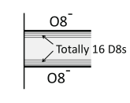
Stringy realization of the Abelian theory
Type IIA string theory on AdS₄*CP³ are dual to the d=3 N=6 Chern-Simons theory (ABJM theory)
Aharony-Bergman-Jafferis-Maldacena ``08
Introduction of orientifold 8-planes can realize the AdS/BCFT.
Fujita-Takayanagi-Tonni ``11
The 10-dimensional metric of AdS₄*CP³
The orientifold projection: y→ -y
even under the orientifold : Φ, g, C₁, odd under it: B₂, C₃
8 chiral fermions for each boundary

Slide 26
Stringy realization
After dimensional reduction to d=4, we obtain the Abelian action of the massless gauge fields
M/k: number of B₂ flux
for no O-planes, Hikida-Li-Takayanagi ``09
satisfying the Dirichlet boundary condition at the boundaries.
Dirichlet b.c.
F
F
Cf. Neumann b.c.
y
y
O8⁻
O8⁻

Slide 27
Stringy realization
This system realizes the FQHE and the Hall conductivity
σ_{xy}=M/2πk
The SL(2,Z) action of σ_{xy}
Vanishing longitudinal conductivity!

Slide 28
Discussion
We analyzed the response of a conserved current to external electromagnetic field in the AdS/BCFT correspondence.
This allows us to extract the Hall current.
Analysis of the action of a duality transformation
String theory embedding of the abelian theory

Slide 29
Future direction
Application to the BH solution with the boundary breaking the translation invariance
Analysis of the (1+1)-dimensional boundary states
Using the AdS₃/dCFT₂ correspondence and the Yang-Mills-Chern-Simons theory (working in progress)
The presence of the anomalous hydrodynamic mode
at the finite temperature

Slide 30
Modular Action on Current 2-point function
S operation has been studied in the case of N_{f} free fermions
with U(1) gauge group for large N_{f}
Borokhov-Kapustin-Wu ``02
The effective action becomes weak coupling proportional to
The large N_{f} theory has the property that the current has nearly Gaussian correlations
Complex coupling (t>0)

Slide 31
: a universal number analogous to the level number of the Kac-Moody algebra in 1+1 dimensions
K: a universal number analogous to the level number of the Kac-Moody algebra in 1+1 dimensions

Slide 32
Modular Action on Current 2-point function
The effective action of A_{i} after including gauge fixing k_{i}A_{i}=0
The propagator of A_{i} is the inverse of the matrix
The current of the theory transformed by S:
The 2-point function of
Τ → -1/τ compared with <J J>

Slide 33
Action of SL(2,Z) on CFT
S transformation is used to describe the d=3 mirror symmetry.
Kapustin-Strassler ``99
Defining the current of the dual theory
the action after S-transformation becomes
T action adds the Chern-Simons action

